Slide 1
YggFinance
Progress Update

Slide 2
Introduction
YggFinance Personal Finance Web Application
Monthly Budgeting
Savings Planning
Net Worth Tracking.
Order of Presentaion:
Web Application UI
Backend Docker Microservices
Server Setup and Configuration

Slide 3
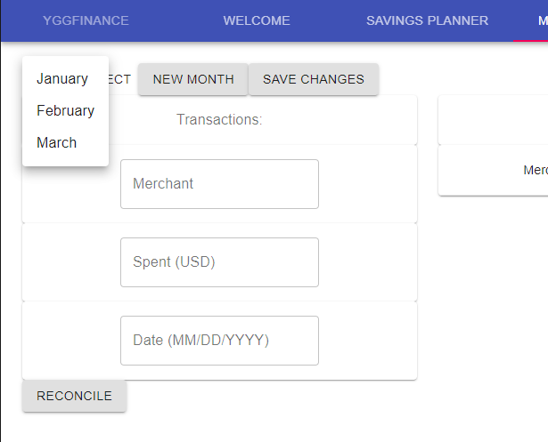
YggFinance Web App - Changes
Using text fields for Monthly Budget data
EditTableAPI last updated 2017
Using text field for time period selection
Slider gives less freedom
Dropdown menu for month names
Easier for data manipulation

Slide 4
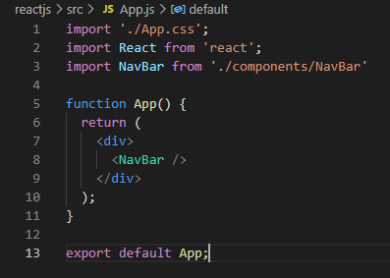
YggFinance Web App - Completed
Entirety of App contained within NavBar(Top Menu)
Allows the use of TabPanel to separate pages
Pages load simultaneously
Welcome Page
Full descriptions of all tools available
Savings Planner page
UI elements laid out. Prepared for data testing through server
Data tables are compartmentalized to their own .js script
Monthly Budget page
UI Elements laid out
Reconciliation currently disabled
History table compartmentalized to its own .js script
Net Worth Page
UI Elements laid out
Ready for local UI data handling

Slide 5
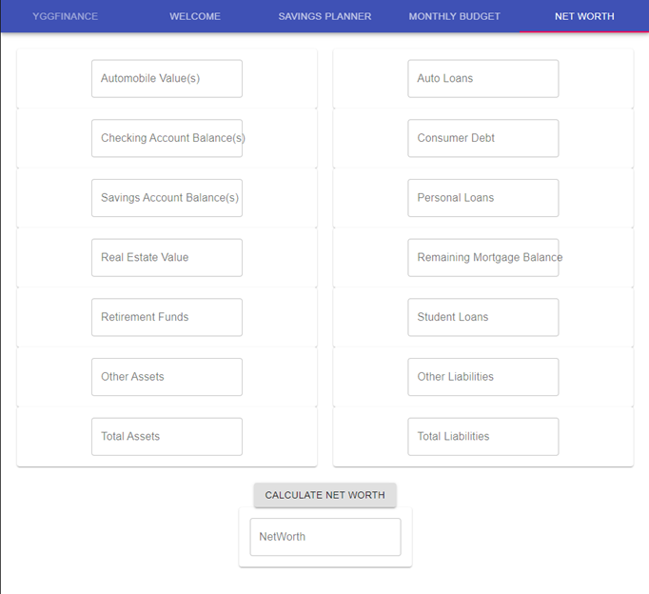
YggFinance Web App - In Progress
Testing data handling locally through Net Worth page
All other data will be transferred through server to back end
Dockerizing App pages for server communication
Editing all pages to look more clean (professional)
Customization from defaults is a long process

Slide 6
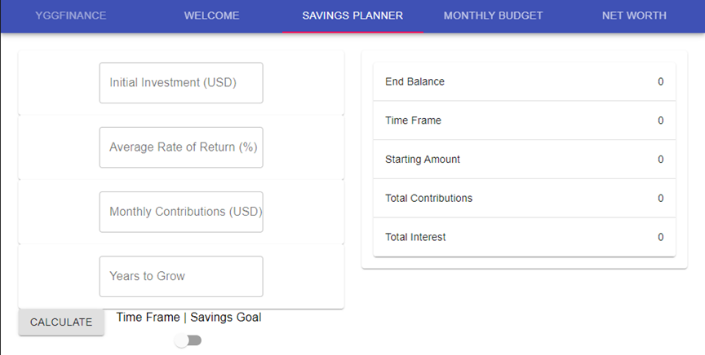
YggFinance Web App - To be Implemented
CSV file handling
No CSV, no reconciliation
Upload Button
Selectable data labels for currencies (select text fields)
Data input validation through the UI (helpertext)
UI grid editing

Slide 7
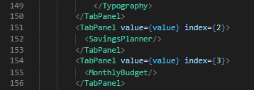
YggFinance Web App - Potential Issues
Items are compartmentalized
Proper communication of data
Stored user data loaded upon app load
User sign-in?
Auto-update item fields

Slide 8

Services - Backend
Monthly Budget
Parse CSV
Filter/transform CSV
Savings Planner
Calculate time frame
Calculate future value
Net Worth
Networth = Assets - Liabilitites

Slide 9
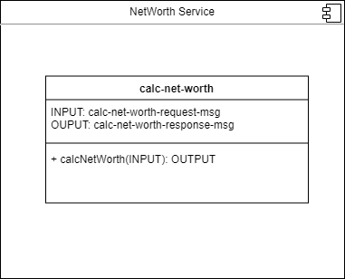
Functions - Completed
Planning service
calcTimeFrame()
calcEndBalance()
Net Worth service
calcNetworth()
Returns JSON format

Slide 10
Services - In Progress
Monthly Budget
Filter certain CSV columns
JSON message input and output function
Each service needs to be containerized for Docker

Slide 11
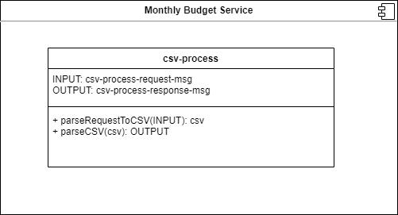
Services - Potential Issues
It will be a challenge to figure out how to filter out unnecessary data from the CSV files
One possible solution would be to configure the CSV parsing to fit a specific format directly related to a specific financial institution
// set fields
hasHeaders: boolean
merchantColumn: string
amountColumn: string
dateColumn: string
// appended files
file: file
csv-process-response-msg

Slide 12
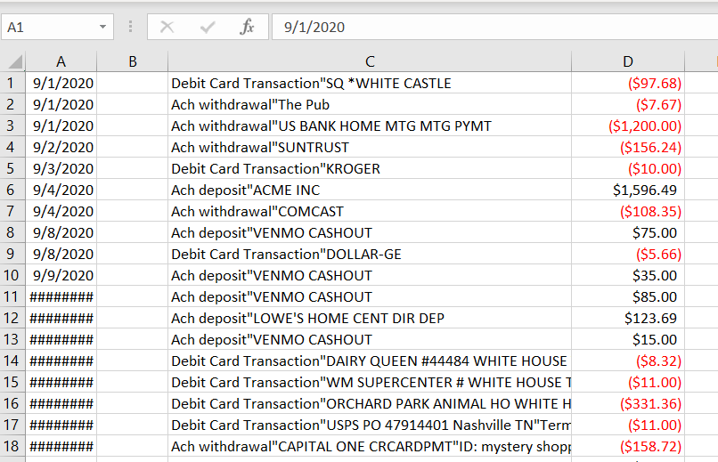
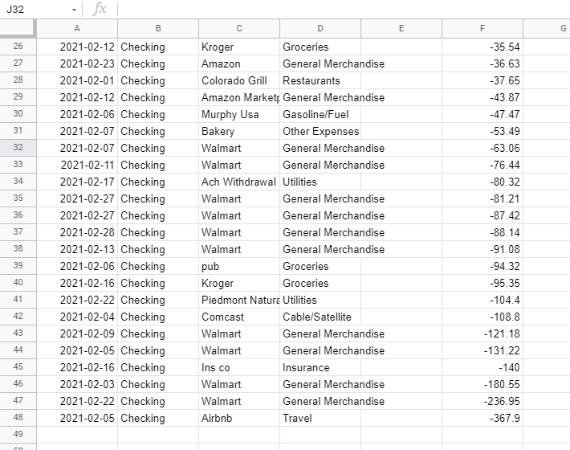
Services - Changes
No official changes on backend
Challenges with CSV manipulation are being faced

Slide 13
Yggdrasil Server - Issues
Host on LAN? Easy and lots of experience with!
Q. How about opening it to the internet?
Have fun with that!
Issues:
Port Forwarding
Domain acquisition
Static IP Addresses
Dedicated Public IP Addresses
A Headache...

Slide 14
Yggdrasil Server - Issues (cont.)
Q. How about using AWS?
Issues:
High Learning Curve
Pricing is impossible to figure out (free? Or $0.36? Or what?)
Too many services (you can do the same thing in 5-10 different ways with different costs)
Q. How about another Hosting Provider?
Try to find a free VPS, it’s hard and often incredibly limited…
We decided to direct our efforts elsewhere on this front.

Slide 15
Yggdrasil Server - Solution
The solution? Tunneling to a proxy!
Local Tunnel
No need to open router ports
All traffic is wrapped in a TLS tunnel to the proxy server only.
No need to have a static or dedicated IP
Free choice of subdomain (3rd level domain) names*
*assuming they aren’t currently in use.
Free and Open Source Software (FOSS)!
Https connection: https://yggfinance.loca.lt

Slide 16
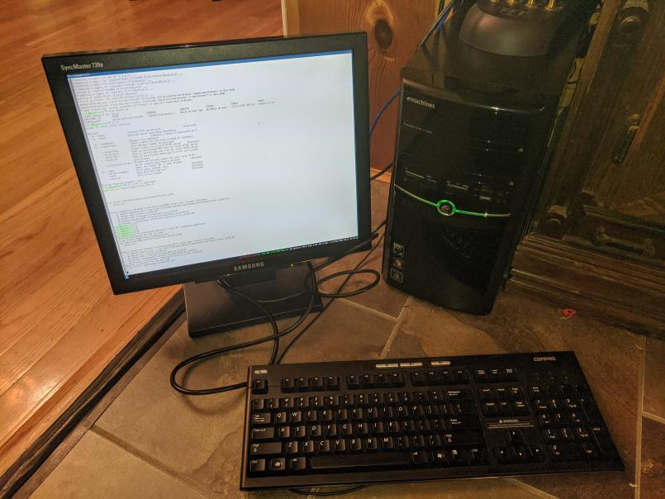
Yggdrasil Server - Completed
Yggdrasil Server Setup:
Machine: Emachines ET1331G-07w
OS: Ubuntu Server 20.04.2
apt:
docker
docker-compose
npm(Node Package Manager)
ruby
i3 desktop environment
openSSH server
npm :
localtunnel
ruby gem:
localtunnel-restarter

Slide 17
Yggdrasil Server - To be Completed
Docker:
DockerCompose Configuration File
Docker Network
Reverse Proxy nginx container
Integration and Deployment of completed project pieces.

Slide 18
Yggdrasil Server - Potential Issues
LocalTunnel likes to crash every once in a while (network instability)
Solution: localtunnel-restarter ruby gem
No experience setting up a reverse proxy before
DoSing/DDoSing?
Easy to change subdomain name
Non-tunneled requests directly to the IP dropped.
Security?
Low Value Target
Isolated vLAN
All requests are effectively over a reverse VPN
Good enough for a demo

Slide 19

Conclusion
Mostly on track for project completion
Minor UI Changes
No Major Backend Code Changes
Self-Hosting instead of Hosting Service

